Slide 1

Image processing & analysis
SADL
KU Leuven

Slide 2
Table of content
Satellite sensors
Image visualisation
Spectral signature
Derived indices
Image classification techniques

Slide 3
Learning objectives
At the end of the course participants should be able:
To explain what a true and false colour composite is
to explain the relevance of spectral signatures for image classification
Explain raster calculator & NDVI

Slide 4
Satellite sensors
1

Slide 5
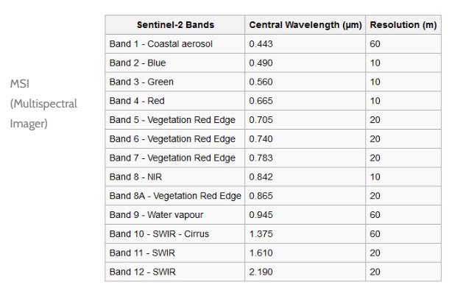
Sensor characteristics
E.g. Sentinel-2A Satellite Sensor (10m)
Determines possibilities for analysis:
RGB
Multispectral: collect data throughout a limited portion of the electromagnetic spectrum (five to ten bands); typically, it’s RGB (red, green, and blue — the three primary colors) and a handful of infrared bands
Hyperspectral: satellites can distinguish thousands of individual light spectrum bands
Satellite Imaging Corporation, n.d.
Notes:
EOS. (2021, September 8). Multispectral vs. hyperspectral imaging. EOS. https://eos.com/blog/multispectral-vs-hyperspectral-imaging/
Satellite Imaging Corporation. (n.d.). Sentinel-2A. Satellite Imaging Corporation. https://www.satimagingcorp.com/satellite-sensors/other-satellite-sensors/sentinel-2a/

Slide 6
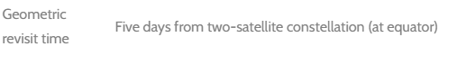
Sensor characteristics
E.g. Sentinel-2A Satellite Sensor (10m)
- Change detection
Notes:
Satellite Imaging Corporation. (n.d.). Sentinel-2A. Satellite Imaging Corporation. https://www.satimagingcorp.com/satellite-sensors/other-satellite-sensors/sentinel-2a/

Slide 7
Image visualisation
2

Slide 8
Copernicus Browser

Slide 9
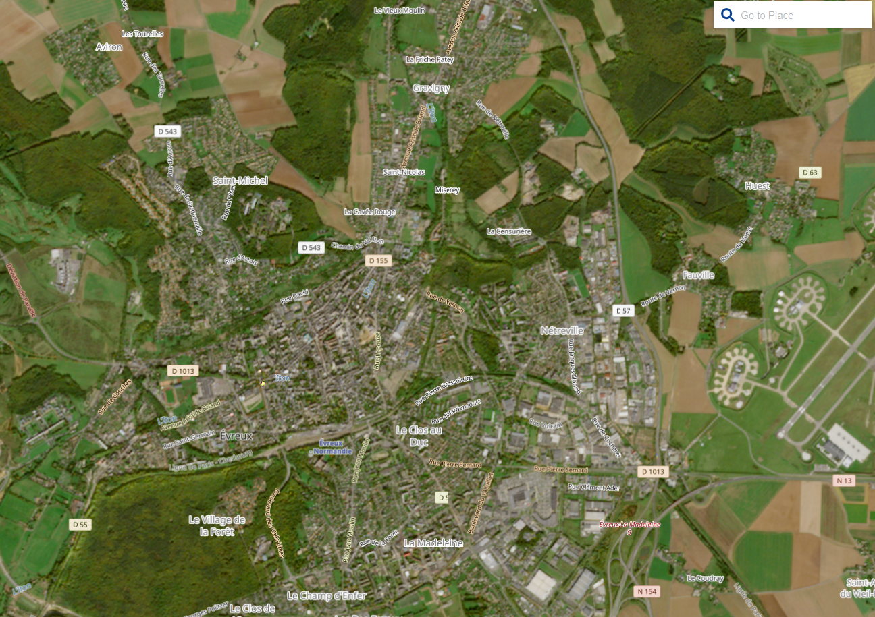
True colour

Slide 10
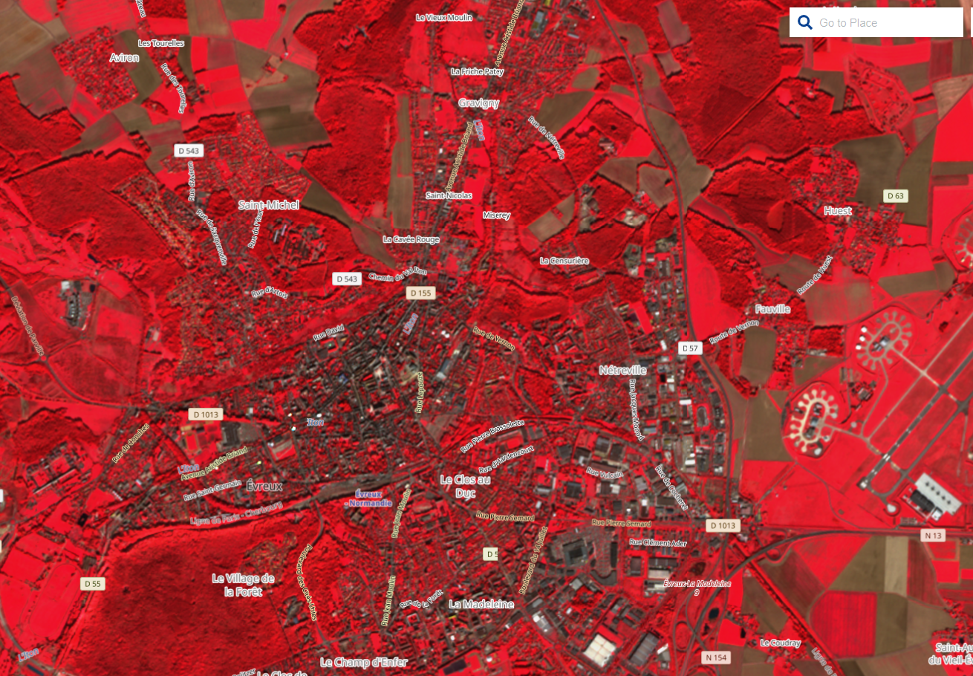
False colour

Slide 11
False colour

Slide 12
Spectral signature
3

Slide 13
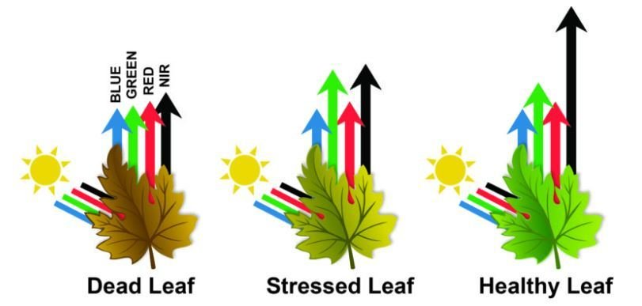
Reflection of electromagnetic waves
Radiation can be absorbed by a target, transmitted through a target or reflected. The proportion of each depends on the wavelength and surface features.

Slide 14
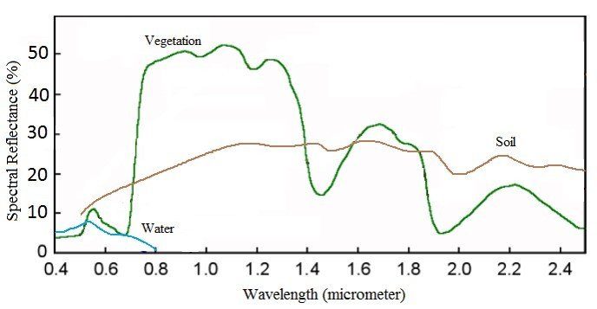
Spectral reflectance curve
Spectral signature
Spectral Reflectance is the amount of energy reflected from a surface at a specific wavelength.
Analysis of the spectral reflectance signatures
allows to distinguish different surface feature
or materials.
Spectral reflectance curve presents the
reflectance of objects as a function of wavelengths.

Slide 15
Derived indices
4
Notes:
DERIVING REMOTE SENSING INDICES FROM SENTINEL 2 SATELLITE IMAGERY IN GOOGLE EARTH ENGINE | by LAWRENCE KIMUTAI | Medium

Slide 16
Derived indices
Produce 1 indices that indicates information about a specific characteristic
Combines different bands
Examples:
NDVI (Normalized Difference Vegetation Index)
NDWI (Normalized Difference Water Index)
EVI (Enhanced Vegetation Index)
GCI (Green Chlorophyll Index)
NDBI (Normalized Difference Built-Up Index)
…

Slide 17

NDVI
Normalized Difference Vegetation Index
the greenness and the density of the vegetation captured in a satellite image
Healthy vegetation has a very characteristic spectral reflectance curve which we can benefit from by calculating the difference between two bands – visible red and near-infrared

Slide 18

NDVI
Normalized Difference Vegetation Index
$$NDVI=\frac{NIR −RED}{NIR+RED}$$
NIR – light reflected in the near-infrared spectrum
RED – light reflected in the red range of the spectrum
values ​​from -1.0 to 1.0: (indications)
negative values: mainly formed from clouds, water and snow
​close to 0: primarily formed from rocks and bare soil
small values ​​( <= 0.1): empty areas of rocks, sand or snow
moderate values ​​(0.2 - 0.3): shrubs and meadows
Large values ​(0.6 - 0.8): temperate and tropical forests
Notes:
https://eos.com/make-an-analysis/ndvi/

Slide 19
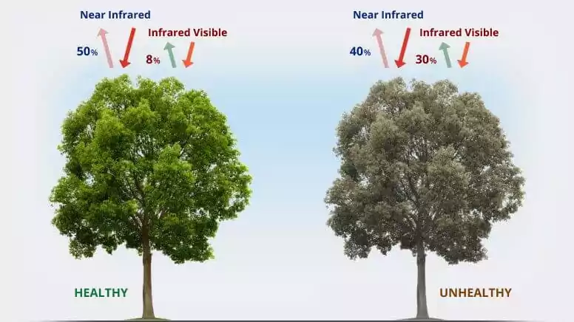

NDVI
$$NDVI=\frac{NIR −RED}{NIR+RED}$$
Normalized Difference Vegetation Index
Chlorophyll (a health indicator pigment) strongly absorbs visible light, and the cellular structure of the leaves strongly reflects near-infrared light.
When the plant becomes dehydrated, sick, afflicted with disease, etc., the spongy layer deteriorates, and the plant absorbs more of the near-infrared light, rather than reflecting it.
Thus, observing how NIR changes compared to red light provides an accurate indication of the presence of chlorophyll, which correlates with plant health.
EOS, n.d
Notes:
EOS. (n.d.). NDVI: Normalized difference vegetation index. EOS. https://eos.com/make-an-analysis/ndvi/

Slide 20
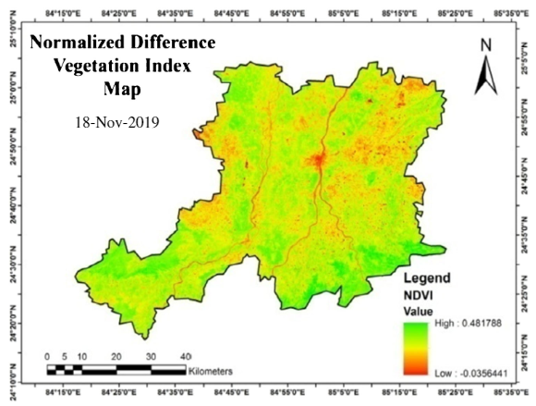
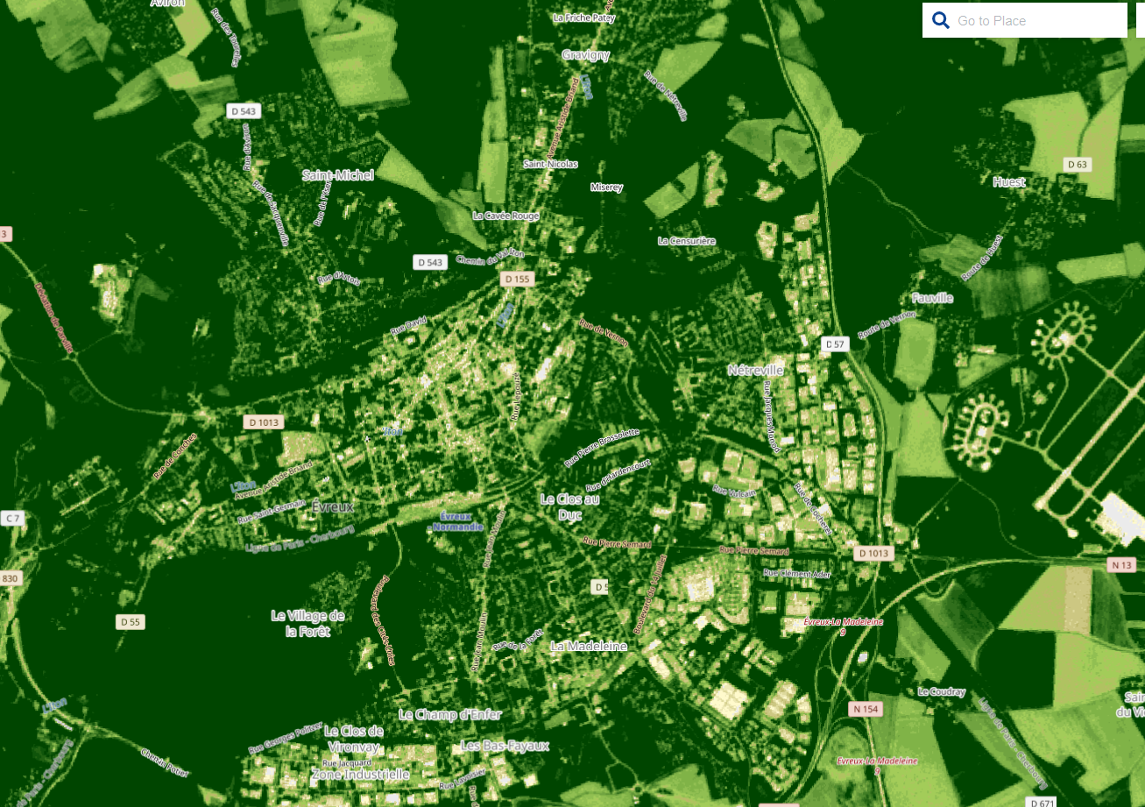
NDVI
Normalized Difference Vegetation Index
Notes:
https://eos.com/make-an-analysis/ndvi/

Slide 21

NDBI
Normalized Difference Built-Up Index
highlights urban areas where there is typically a higher reflectance in the shortwave-infrared (SWIR) region, compared to the near-infrared (NIR) region
Applications; watershed runoff predictions, land-use planning, …
An urban area or built-up area reflects more short-wave infrared (SWIR) than near-infrared (NIR) as similar as bare soil
separates the built-up land from barren and bare areas to some extent
Value from −1.0 to +1.0:
Negative values: suggest waterbodies
values near zero: vegetated areas
value approaching to +1: urban area shows the high value
$$NDBI= \frac{SWIR −NIR}{SWIR+NIR}$$
Notes:
NV5 Geospatial Software. (n.d.). Background on other indices. NV5 Geospatial Software. https://www.nv5geospatialsoftware.com/docs/BackgroundOtherIndices.html
(6) (PDF) Land surface temperature retrieval from TIRS data and its relationship with land surface indices (researchgate.net)

Slide 22
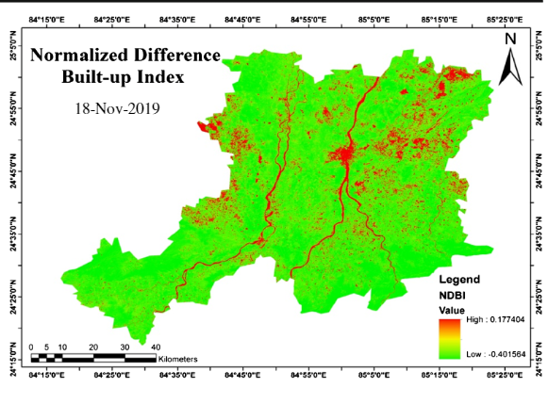
NDBI
Normalized Difference Built-Up Index
Notes:
Omar, P. J., & Kumar, V. (2021). Land surface temperature retrieval from TIRS data and its relationship with land surface indices. Saudi Society for Geosciences. https://www.researchgate.net/publication/354288285_Land_surface_temperature_retrieval_from_TIRS_data_and_its_relationship_with_land_surface_indices

Slide 23
Exercise
4.2

Slide 24
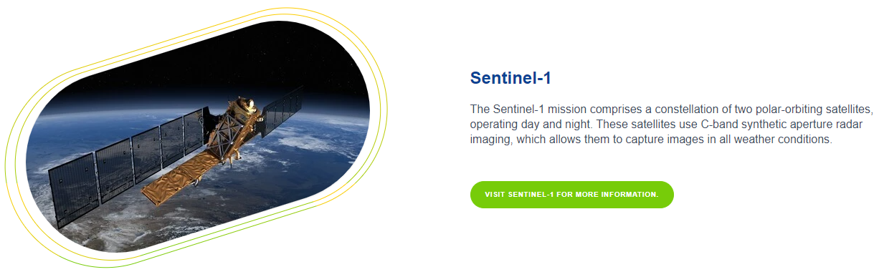
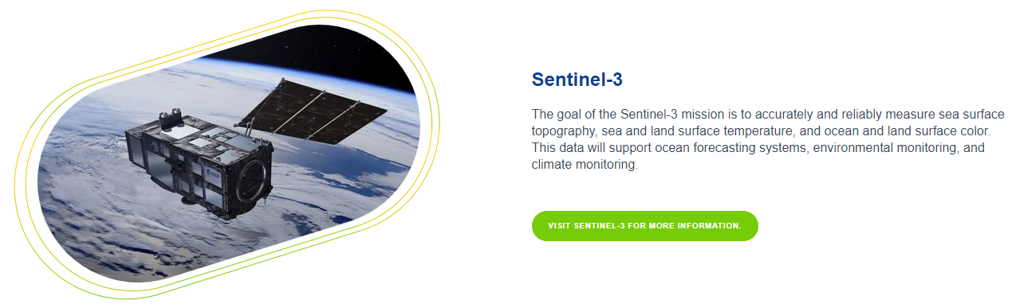
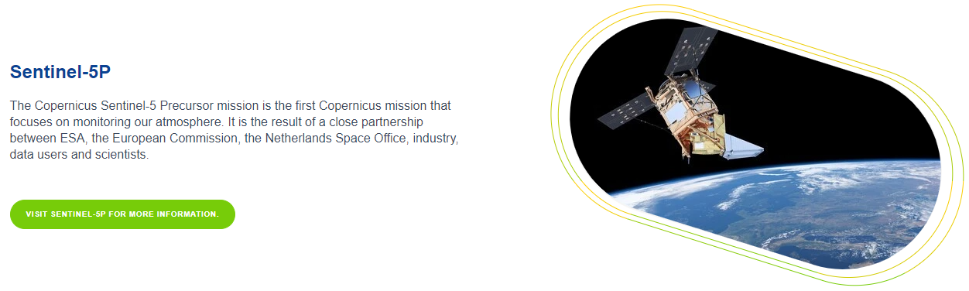
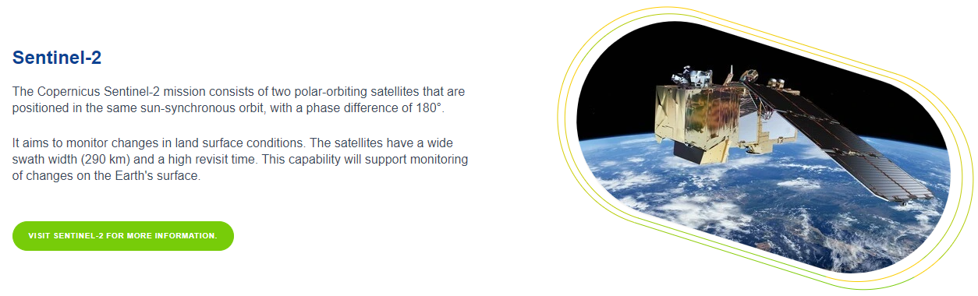
Different Sentinel satellites

Slide 25
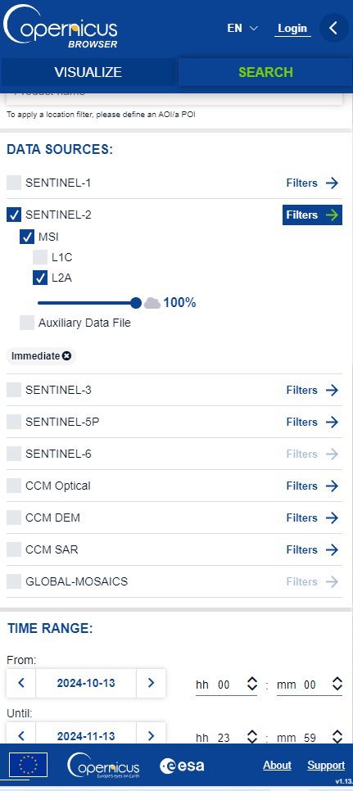
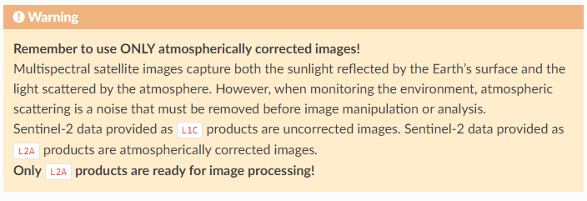
Get Data
https://browser.dataspace.copernicus.eu/
Notes:
3.3. Access to Copernicus satellite images for free — GIS4Schools documentation →!
How to Download Free Sentinel Satellite Data - GIS Geography

Slide 26
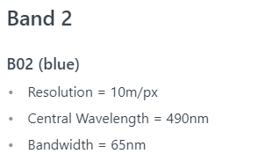
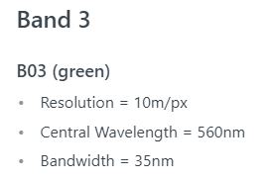
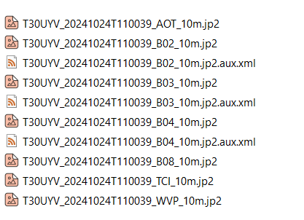
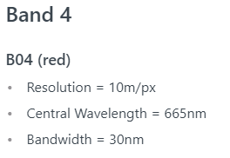
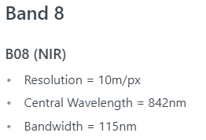
Open data
Where to find data?
xyz.SAFE\xyz.SAFE\GRANULE\xyz\IMG_DATA
?
Sentinel-2 Bands | Sentinel Hub custom scripts
Notes:
Sentinel-2 Bands | Sentinel Hub custom scripts

Slide 27
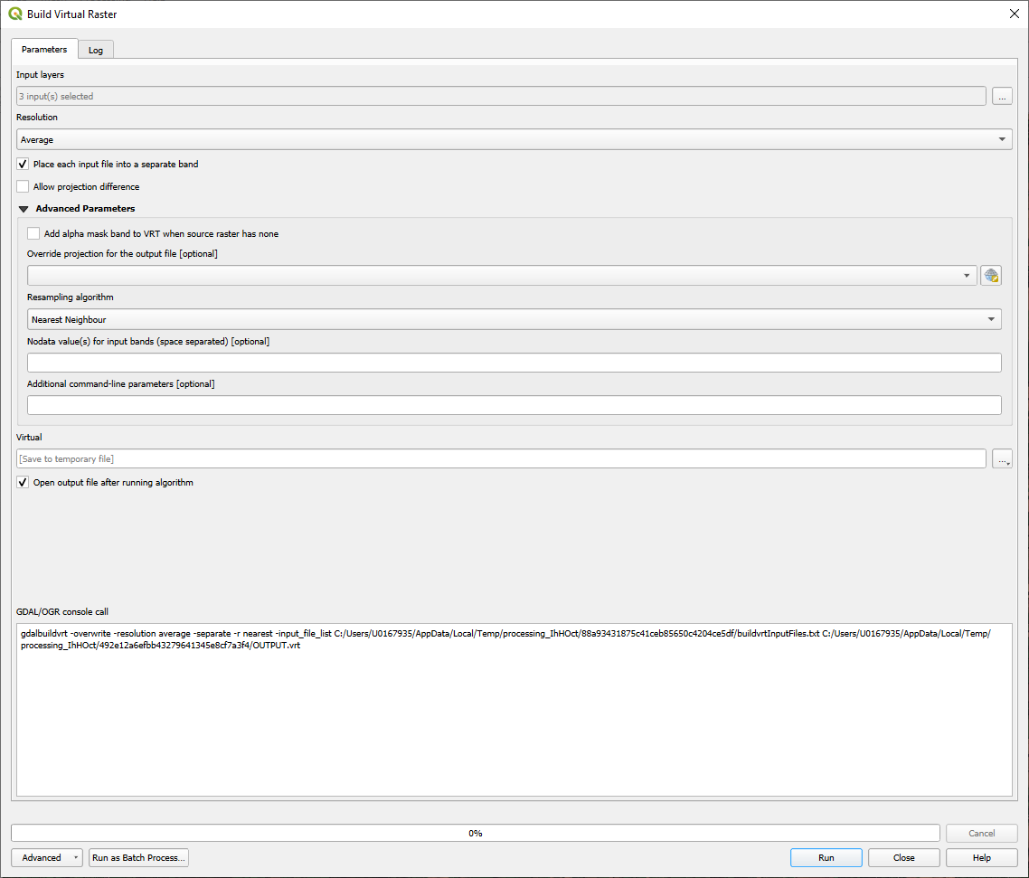
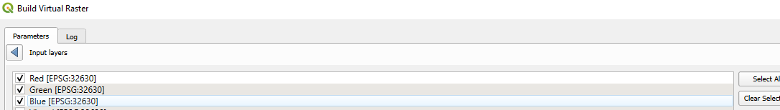
In GIS
Load individual layer (Rename with F2)
Combine into one: Built Virtual Raster
TIP: rename layers with F12

Slide 28
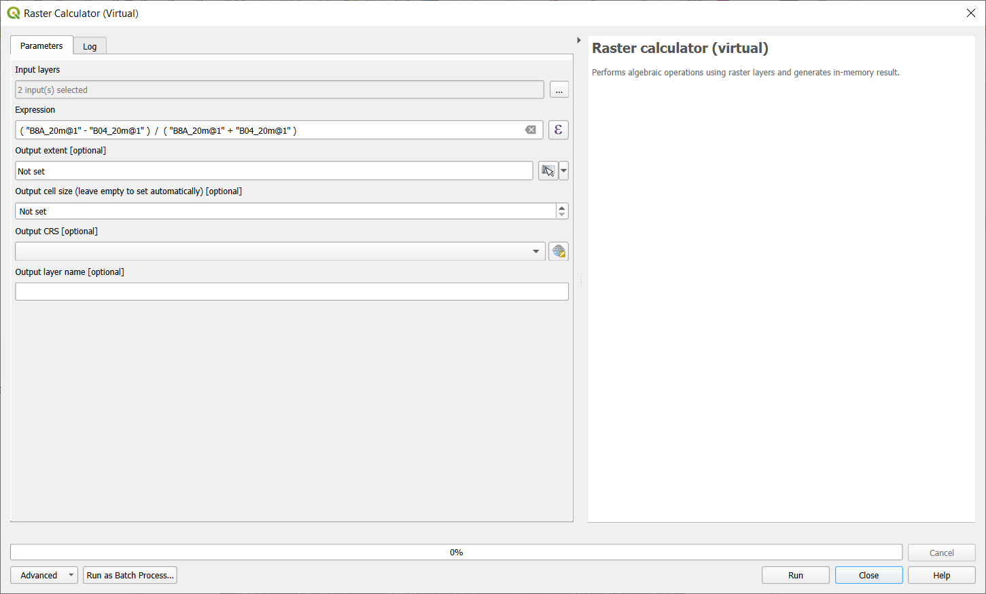
NDVI
Sentinel 2

Slide 29
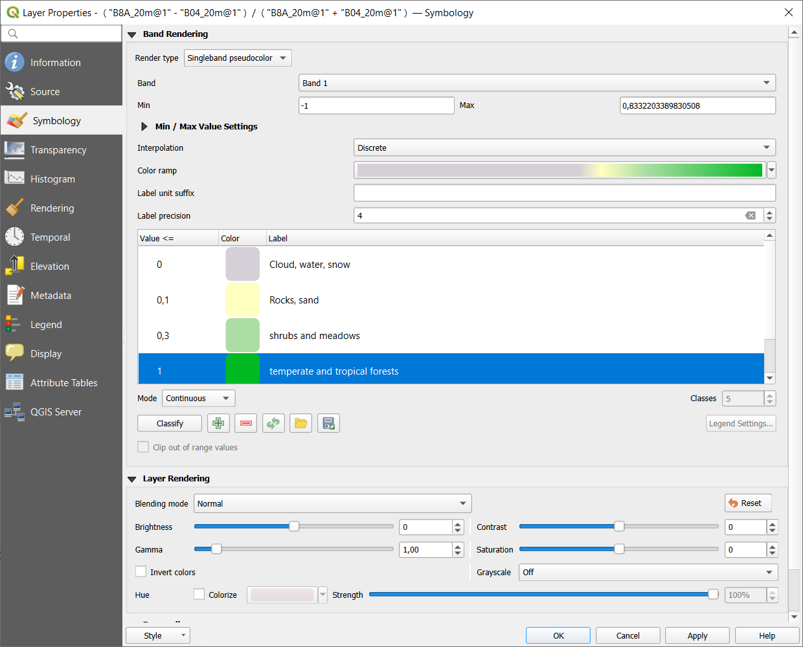
NDVI
Sentinel 2

Slide 30
Image classification techniques
5

Slide 31
Classification techniques
Context of RS: assigning a class to each pixcel
4 main types of image classification techniques in remote sensing are:
Unsupervised image classification
Supervised image classification
Object-based image analysis
Deep learning object detection
Low spatial resolution images: both traditional & object-based classification works well
High spatial resolution images: OBIA superior
Notes:
GISGeography. (n.d.). Image classification techniques in remote sensing. GISGeography. https://gisgeography.com/image-classification-techniques-remote-sensing/

Slide 32
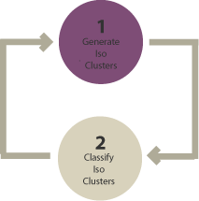
Unsupervised classification
How?
Groups pixels into “clusters” based on their properties [Generate clusters]
You classify each cluster with a land cover class [Assign classes]
Most basic technique
image clustering algorithms
K-means
ISODATA
Clusters determined by user:
More clusters = less variability within one, but more between classes.

Slide 33
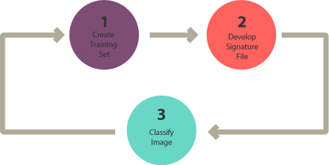
Supervised classification
3 basic steps:
Select training areas/sites/samples : select representative samples for each land cover class
Generate signature file
Classify
For each land cover class, you continue creating training samples
until you have representative samples for each class.
In turn, this would generate a signature file, which stores all training samples’ spectral information.

Slide 34
Supervised classification
Spectral information (signature) used to classify other pixels.
Different algorithms:
Maximum likelihood
Minimum-distance
Principal components
Support vector machine (SVM)
Iso cluster
→ Test them

Slide 35
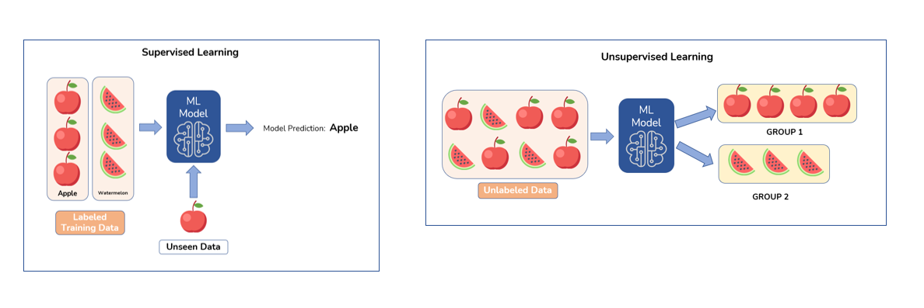
Unsupervised classification vs Supervised classification
Devashree, 2022
Notes:
Devashree. (2022, September 1). Unsupervised learning in image classification. AmyGB. https://www.amygb.ai/blog/unsupervised-learning-in-image-classification

Slide 36
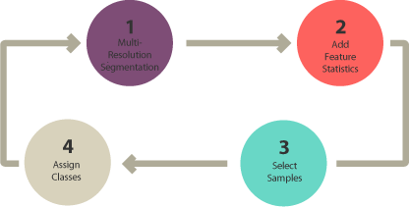
Object-based image analysis
Supervised & unsupervised = pixel-based classification
<>
Object-based: groups pixels into shapes (vector: size & geometry)
Steps:
Perform multiresolution segmentation (groups pixels)
Select training areas
Define statistics
Classify

Slide 37
Object-based image analysis
Segmentation: if objects are very clear it can be done by software
Segmentation methods:
Multi-resolution segmentation
Segmentation mean shift
Notes:
Image Classification Techniques in Remote Sensing (gisgeography.com)

Slide 38
Object-based image analysis
Classification methods:
Shape e.g. rectangle ≈ building
Texture: homogeneity e.g. water
Spectral: mean values R, G, B, NIR, SWIR
Geographic context: proximity & distance relationship neighbours
Nearest neighbour classification: similar supervised classification
Multi-resolution segmentation
User identifies sample sites
Statistics for objects
NN classifies objects based on previous
Notes:
GISGeography. (n.d.). Image classification techniques in remote sensing. GISGeography. https://gisgeography.com/image-classification-techniques-remote-sensing/

Slide 39
Deep learning object detection
Form of AI
Fast growing
Learn from large datasets

